Slide 1






ACTION PLAN
UMBRIA REGION
Emanuela Bossi
ebossi@regione.umbria.it
Virtual meeting - Exchange Session
24 Febbraio 2021
Notes:
1

Slide 2
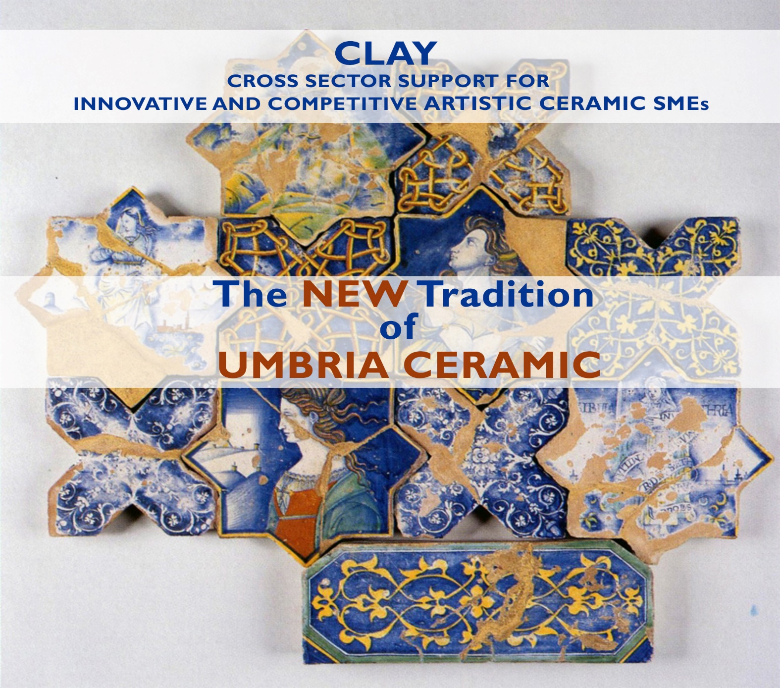
ACTION PLAN

Slide 3

ACTION PLAN
The Umbrian soil rich in clay, with plenty of water, woods and the presence of wood-burning furnaces. The territory is ideal for powering the production of pottery and ceramics, offering a wide range of products that speak to the world of the Umbrian territory.
Throughout the history of Umbria, especially its relationship with this art, lives of individual collective destinies have intertwined with habits, customs and social relations determined by economic activity, often in the endless pursuit of beauty for pure beauty. Pottery is on the one hand, an historic event, calling for a precise reconstruction of scientific rigour and passionate cultural momentum. On the other, an artistic expression that goes beyond the chronological limits of historical events, being admired as an object worthy of representing the territory and the its people.
Virtual Meeting Exchange Session

Slide 4
ACTION PLAN
1. INTRODUCTION
The CLAY project was born with the aim of facilitating and improving innovation processes in the traditional ceramic sector
In Umbria artistic ceramics, are a traditional sector largely made up of small and micro enterprises
The globalization can be a challenge for this sector:
the ceramic sector must prioritize new technologies, strengthen brands and develop services to maintain a competitive edge.
The CLAY project has helped to assess how regional policy strategies can support ceramic innovation processes

Slide 5
ACTION PLAN
3. POLICY CONTEXT
This action concerns ERDF Regional Operational Programme Umbria 2014-2020
In particular, it addresses:
1. Specific objective 3.3 "Increase of the level of insourcing within the production
sector".
2. Key action 3.3.1. – “Projects to promote company exports and territorial/sector
based clusters”.
Operational Programme Umbria ROP ERDF contribution is 50%

Slide 6
ACTION PLAN
4. ACTION INCLUDED IN THE ACTION PLAN
UNIVERSITY - COMPANY
- COLLABORATIVE RESEARCH –
FINANCIAL INCENTIVES– GRANT SCHEME
The action objective is to create a collaborative research between Ceramic Companies and the University on new knowledge, new skills and innovations in the field of ceramics thanks to the FINANCIAL INCENTIVES / GRANT SCHENE.

Slide 7
5. DETAILS OF THE ACTION ENVISAGED
5.1 Policy Need addressed
Umbria is one of the few regions in Italy that can boast six municipalities with the ancient tradition of ceramics: Deruta, Gualdo Tadino, Gubbio and Orvieto, Città di Castello and Umbertide.
The ceramic tradition is so strong in Umbria that it can sometimes be an weakness
The economic crises have increased the structural weaknesses of the ceramics sector
.
Internationalization may be a future challenge
With the innovation in production, marketing and product / design, historic brands can achieve greater competitiveness also in foreign markets
An important role for the territory development can be played by
universities and research centers
Many ceramic companies, especially small and micro companies do not know the role that the University could play in supporting them

Slide 8
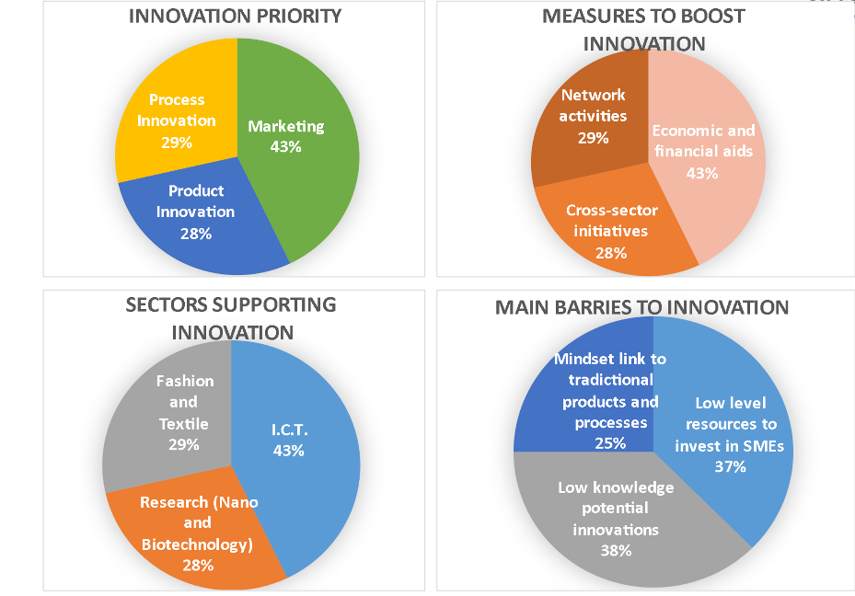
5.1 Policy Need addressed
Key results of the CLAY comparative needs analysis

Slide 9
5. DETAILS OF THE ACTION ENVISAGED
5.1 Policy Need addressed
The innovation in marketing and product is the most urgent needs to be addressed

Slide 10
5. DETAILS OF THE ACTION ENVISAGED
5.1 Policy Need addressed
Grants and financial incentives are the most requested support measures

Slide 11
5. DETAILS OF THE ACTION ENVISAGED
5.1 Policy Need addressed
The lack of knowledge of possible innovations and the lack of human / financial resources shows that financial incentives alone cannot effectively meet the needs of Umbrian Ceramics SMEs

Slide 12
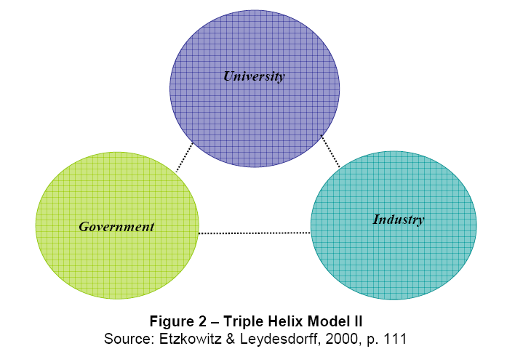
5. DETAILS OF THE ACTION ENVISAGED
5.2. Overview of the policy instrument that this action refers to
An effective support program for the Umbrian territory should integrate economic aid in a wider framework of collaboration with research / training institutes that accompany SMEs along the entire innovation path.
Innovative processes require interactions between tree different actors
Collaboration between University and industry/company is a key component for the effective result exploitation in the R&D
and for regional competitiveness

Slide 13
5. DETAILS OF THE ACTION ENVISAGED
5.2. Overview of the policy instrument that this action refers to
ACTION - UNIVERSITY - COMPANY- COLLABORATIVE RESEARCH –
FINANCIAL INCENTIVES FOR SMES – GRANT SCHEME
This ambitious action aims to support companies to access innovation in collaboration with the University of Perugia.
This objective can be achieved through the collaboration between different Departments of the University of Perugia that carry out R&D in sectors of relevance to ceramics and the SMEs looking to innovate, especially those that do not have an R&D laboratory / department
Support from the University can help to promote:
1. product innovation and design quality;
2. innovation in production processes;
3. innovative marketing strategies and tools.
A framework agreement will be signed between the Umbria Region and the University
The grant is dedicated to cover the cost for the innovation service provided by the University

Slide 14
5. DETAILS OF THE ACTION ENVISAGED
5.2. Overview of the policy instrument that this action refers to
UNIVERSITY - COMPANY- COLLABORATIVE RESEARCH –
Public call for grants
SMEs submit an application, with a specific innovation need (focusing on product, process or marketing innovation),
Applications are evaluated and selected by an Evaluation Committee
The departments negotiate activities with the companies to meet the innovation need and to define the implementation steps and costs
The departments will sign 2 agreements:
1 with the companies ;
2 with the Umbria Region
Umbria Region transmits the admitted application to the various University Departments

Slide 15
5. DETAILS OF THE ACTION ENVISAGED
5.2. Overview of the policy instrument that this action refers to
UNIVERSITY - COMPANY- COLLABORATIVE RESEARCH –
The Applications will be evaluated in compliance with specific criteria:
- type of innovation and relevance for internationalization;
quality of technical contents, paying a special attention to timing, objectives and coherence of the project with the company’s development strategy;
- clarity of the proposed actions and operational plan.
Applications are evaluated and selected by an Evaluation Committee

Slide 16
5. DETAILS OF THE ACTION ENVISAGED
5.2. Overview of the policy instrument that this action refers to
UNIVERSITY - COMPANY- COLLABORATIVE RESEARCH –
Once the process is completed and before starting each project, two agreements are signed:
One between the University Department(s) and the SME defining the innovation service(s) that will be provided in the framework of the project and relevant rights and obligations
One between the University Department(s) and the Regional
Government defining the grant amount and the obligations in
terms of implementation, monitoring and reporting.
The departments will sign 2 agreements:
1 with the companies ;
2 with the Umbria Region

Slide 17
ACTION PLAN
PILOT ACTION
This is the first time that such a grant scheme has been experimented in Umbria Region
We asked the Joint Secretariat, Managing Authority, for a Pilot Action
to help us to test the grant procedures before the call.
After a first positive opinion we are working for the final approval
In December 2020 we published a call for expression of interest regarding the action
6 ceramic companies presented the expression of interest for the following needs:
- n. 3 process innovation
- n. 5 product / design
- n. 5 innovation in marketing processes
With the new funds from the a Pilot Action we will be able to satisfy all needs in order to verify the real impact of the action

Slide 18
5. DETAILS OF THE ACTION ENVISAGED
5.3 The Background
The Umbria action was inspired by the Good Practice Thematic Voucher (Innovation, I&D…) “Vale de Inovaçao” from Region do Centro presented during the 4th Interregional Learning Event held in Portugal in February 2020
The elements transferred into the Umbria Action Plan are:
The link between Innovation and Internationalization: the voucher scheme is included under ROP ERDF 2014 – 2020 Thematic Objective 1 “R&D” - Measure 1.2 focuses on innovation for the internationalization supported by Universities and Research Centres
The specialized consultancy: vouchers can be used by SMEs to hire specialized innovation consultancy, which they need, and the service can be provided by a university
The decision to implement a grant scheme, instead of a voucher, was assessed as the best choice to meet the needs of our ceramic SMEs
Umbrian ceramic companies are very different from each other in size (from micro, family-run, businesses, to more structured companies) and for innovation needs.
A grant scheme is more flexible:
allows to evaluate and model the action on the specific innovation needs of SMEs
the grant amount corresponds to the real costs incurred.
Notes:
18

Slide 19
ACTION PLAN
5.5 Player involved
The University of Perugia is the key stakeholder:
With the various Departments that carry out research / studies in the field of process, product and economic / marketing innovation.
With Expert Technical Support in the implementation of the innovation projects
Other stakeholders will be involved as indicated below:
Municipalities with a tradition in artistic ceramics (Gubbio, Gualdo Tadino, Deruta, Orvieto, Città di Castello and Umbertide) will promote our Action Plan and the call in their territories. This will allow to give high visibility to our initiative and to reach all relevant actors in Umbria territory;
Trade associations for crafts and SMEs (Confartigianato, CNA and Confindustria) will promote the call among their members, ensuring that the highest possible number of SMEs can be informed about the call.

Slide 20
Thank you!
Emanuela Bossi
ebossi@regione.umbria.it
“Questions WELCOME”
Notes:
20

